Slide 1
COVID-19 vaccines Regulatory Status Update
25 January 2021
Dr B Semete-Makokotlela
SAHPRA CEO

Slide 2
Vaccine applications submitted to SAHPRA
Vaccine developer | Name | Regulatory status outside SA | Application at SAHPRA | Status at SAHPRA
Janssen | Ad26.CoV2.S. recombinant | EMA submission mid-November 2020 Rolling review | Rolling Review submission for registration | Under review.
AstraZeneca /University of Oxford/Serum Institute of India | AZD1222/COVISHIELD | EMA -submission for marketing authorisation UK Emergency use Listing (EUL) India EUL - COVISHIELD | NDoH submission of S21 | S21 review finalised and authorisation granted on 22 January 2021.
BioNTech/Pfizer | Comirnaty/BNT-162 | Emergency Use Authorisation (EUA) in UK, USA , WHO EUL and Provisional approval EMA | Submitted for registration | Under review

Slide 3
Medicine’s Act Section 21 enabled access
SAHPRA is empowered by Section 21 of the Medicines Act to grant access to an unregistered medicine in such manner and;
  for a period as SAHPRA may determine,
  where conventional therapies have been ruled out, have failed or are unavailable as marketed products.
  for specific quantities and specific individuals/patients
  where adequate scientific data for risk/clinical benefit exists
This must always have regard to the safety, efficacy and the quality of the health product.
Examples of health products that were granted Section 21 authorisation are Remdesivir, SARS-Cov-2 Serology Test Kits, etc

Slide 4
Section 21 application for COVISHIELD™ vaccine
Applicant: National Department of Health
Manufacturer: Serum Institute of India (SII)
Quantity: Initially, 1.5 million doses in bulk supply, thereby avoiding the need to apply on a named-patient basis
Target group: Healthcare workers
Product: COVISHIELD™ vaccine, a ChAdOx1 nCoV-19 Corona Virus Vaccine. The manufacturing is based on technology transfer from Astra Zeneca (AZ).

Slide 5
Regulatory reviews conducted
A thorough review has been conducted by SAHPRA to ensure that the vaccinee will receive safe, efficacious and quality-assured vaccines.
Quality review
Manufacturing facility review
Clinical review
Review of safety and post-access monitoring (incl Pharmacovigilance Reporting Requirements)

Slide 6
Quality review
Manufacturing processes appropriately validated
Comparability was demonstrated between AZ and SII product.
Release specification for SII product identical to AZ
Lot Release-on arrival into country-
  Test and verify the quality of vaccine that is available in SA.
  All SII vaccine lots are subject to lot release by the Indian National Control Laboratory
  All imported lots will also be subject to an additional lot release by the South African National Control Laboratory (SANCL)
  The SANCL lot release process complies with the requirements of the WHO Guideline for independent lot release of vaccines by regulatory authorities

Slide 7
Manufacturing Facility Review:
As part of the Section 21 process, SAHPRA Inspectorate has:
  reviewed the acceptability of Good Manufacturing Practices (GMP) of the site that is producing the vaccine.
  The review considered current positive GMP status of Serum Institute of India as per SAHPRA GMP certification process
  Additional desktop review of processes specific to the manufacturing of the COVISHIELD ChAdOx1 nCoV-19 Corona Virus Vaccine
Serum Institute of India has current GMP approval from SAHPRA for the manufacture of two vaccines (BCG vaccine and Rota virus)

Slide 8
Clinical safety and efficacy evaluation
Results of the pre-clinical as well as Phase I and II clinical studies were reviewed in detail and have shown acceptable safety efficacy outcomes.
The review of the early results of the ongoing Phase III studies have shown acceptable safety and 70 % efficacy profile for the vaccine.

Slide 9
Pharmacovigilance Reporting Requirements
Manufacturer’s periodic safety update report (PSUR) (worldwide data) on a 6-monthly basis.
Manufacturer’s summary safety report (simplified PSUR) (worldwide data) every month containing:
A summary of Adverse event following Immunization (AEFIs) reported by NDoH to SAHPRA , on a two-weekly basis
(1) estimated exposure;
(2) cumulative and interval adverse Effects tabulations, from post-marketing experience and ongoing trials;
(3) a summary of signals identified, validated, and closed;
(4) changes to the company core data sheet;
(6) an interpretation discussing the risk-benefit balance of the vaccine.
(5) summary of requests from regulatory authorities;
Annual review of drug safety information after depletion of vaccine stocks to identify any other potential risks not captured previously.
NDoH to report serious AEFIs within 24hrs and non-serious AEFIs within 7 days to SAHPRA
A serious AEFIs is defined as “one which requires hospitalization or prolongation of existing hospitalization, causes congenital malformation, results in persistent or significant disability or incapacity, is life-threatening, or results in death.”

Slide 10
Review of safety and post-access monitoring
Pharmacovigilance: Safety monitoring and reporting tool
  Simple practical reporting tool – Med Safety App
  Specific COVID-19 vaccine awareness programs for healthcare professionals and the public has been on-going by the NDoH
    Vaccine safety profile
    Reporting of adverse events following immunization (AEFIs) and the importance thereof
    How to report AEFIs using the Med Safety App
  Causality assessment – the process of determining the relationship between the adverse event and the vaccine - NDoH and SAHPRA
  Adverse events following immunisation (AEFI) are a notifiable medical condition

Slide 11
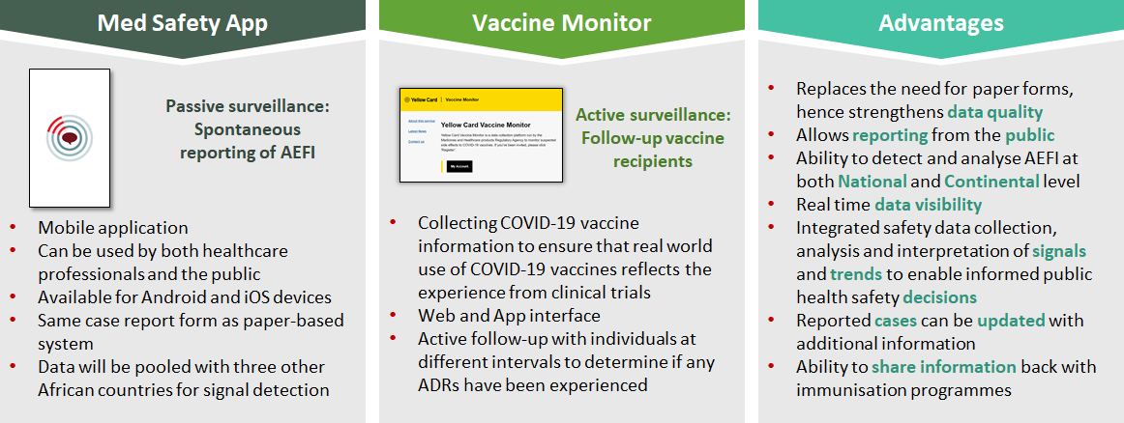
Adverse effect reporting: Med Safety App

Slide 12
Conclusions
A rigorous review process was implemented by SAHPRA
SAHPRA experts with extensive knowledge and expertise were part of the review committee
Extensive collaboration with other regulatory authorities that SAHPRA aligns itself with as well as the WHO is on-going

Slide 13
THANK YOU

